Slide 1



Frontend at Scale
Building Maintainable Applications using Micro Frontends and React

Slide 2

Agenda
What is a micro frontend?
Why should we consider a micro frontend architecture?
How can we create a micro frontend application?

Slide 3


Mehmet Yarar
15+ years
Telecom & IT
5+ years
Full-stack JavaScript Developer
2+ years
Senior Software Engineer at EPAM
Micro frontends
Internationalization
Web Accessibility
Web Security

Slide 4


Slapping the keyboard until something good happens.
Anonymous

Slide 5
Booking App
Application to find and book babysitters, pet-sitters, house cleaners, private teachers, etc.

Slide 6
MVP 1.0 Requirements
Actors
Clients
Service Providers
Functions
Authentication
Profile Management
Search

Slide 7

Monolith
A single code base or a single service
develop, build, test
single artifacts
quick iterations
fast feedback

Slide 8
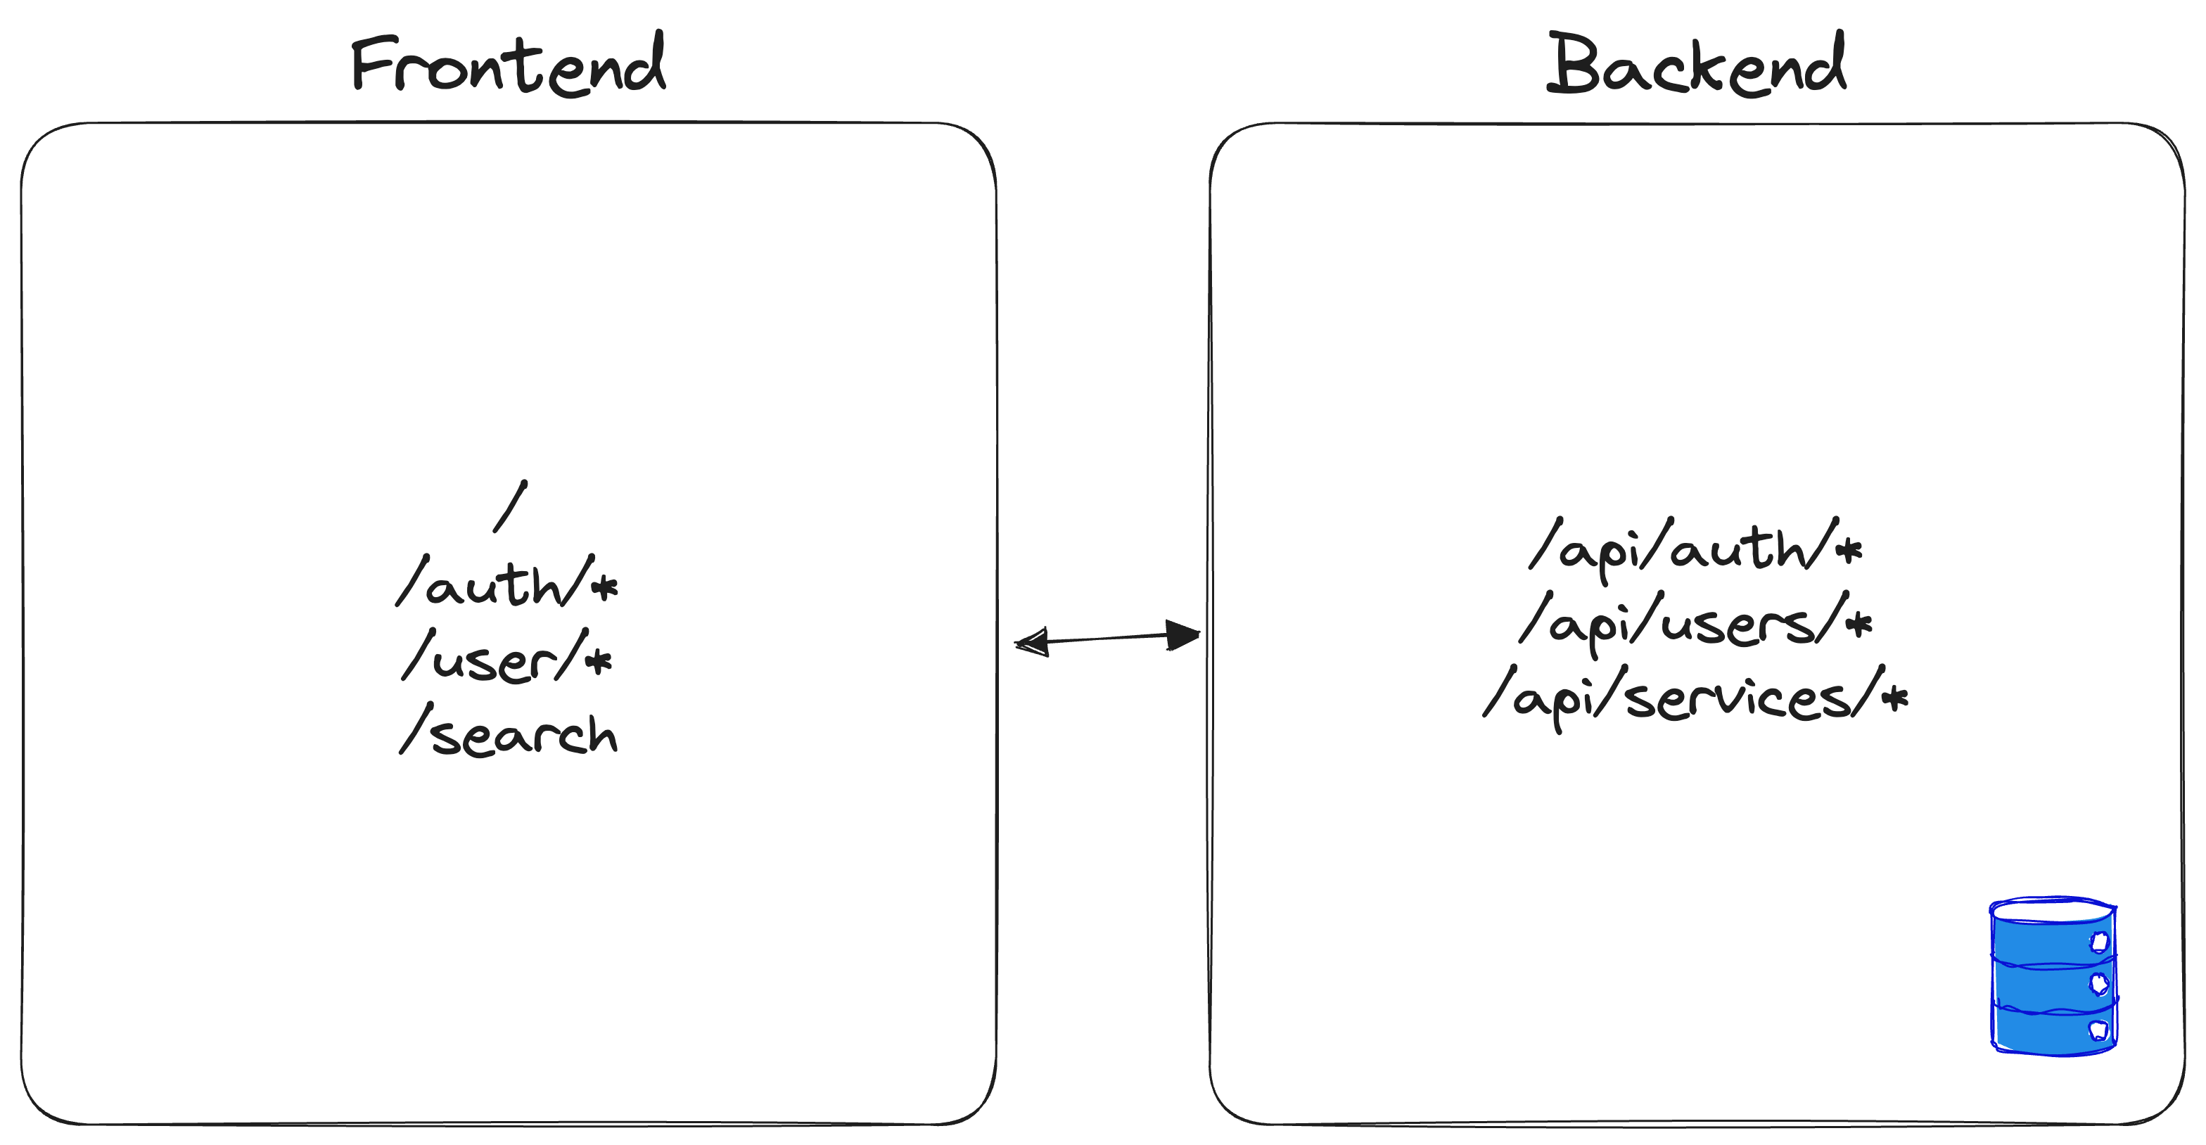
MVP 1.0 - Architecture

Slide 9
MVP 2.0 Requirements
Actors
Clients
Service Providers
Functions
Authentication
Profile Management
Search
Moderators
Booking
Reviews

Slide 10
If you think things are in a mess now, just wait!
Jim Warner

Slide 11
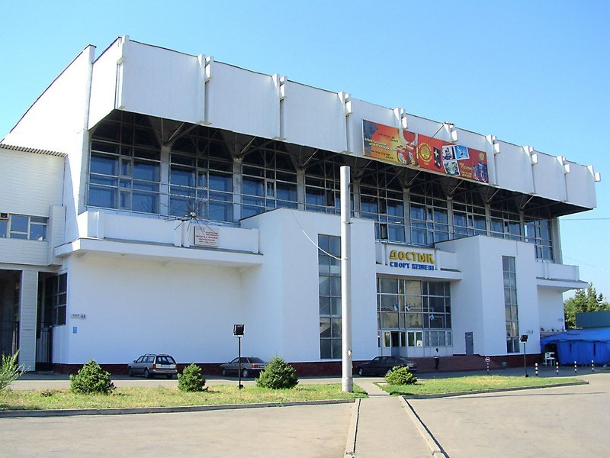
Microservices
Loosely coupled, fine-grained services
develop, build, and test in isolation
fault tolerance
flexible
scalable
Alternative: BaaS - Firebase, Supabase, AWS Amplify

Slide 12
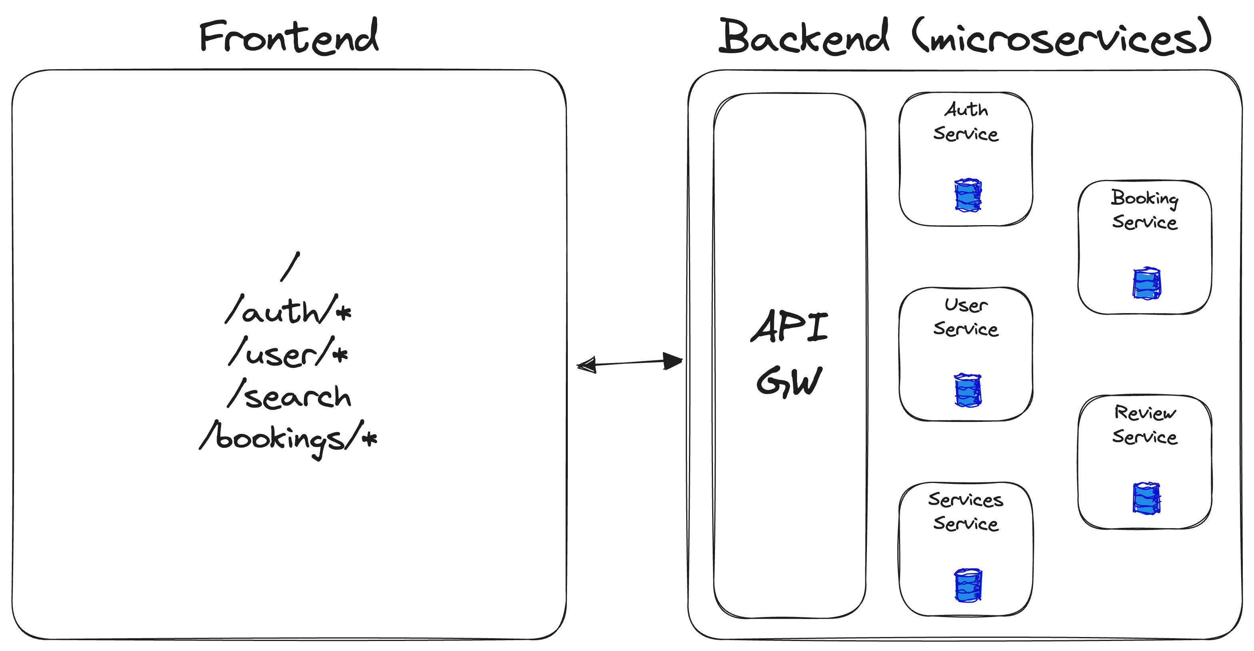
MVP 2.0 - Architecture

Slide 13
Booking App 1.0
Actors
Clients
Service Providers
Functions
Authentication
Profile Management
Search
Moderators
Payment
Booking
Reviews

Slide 14
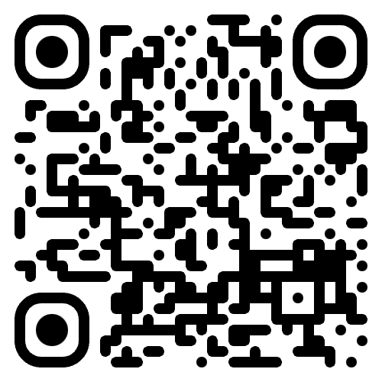
Frontend monoliths are just as good, or as bad, as backend monoliths.
Stefan Tilkov
https://www.youtube.com/watch?v=pU1gXA0rfwc

Slide 15
Could we split our UI into smaller, more manageable units, like we did for the backend?

Slide 16
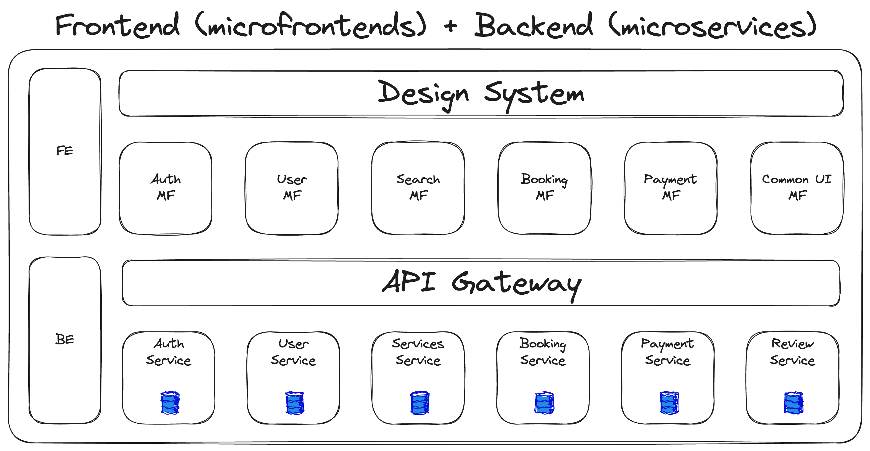
Booking App 1.0 - Architecture

Slide 17
Benefits of Micro Frontends
Independent teams
Reduced communication
Increased productivity
Independent deployments
Faster iterations
Faster feedback
Experimentation
Modernization
Technical Decisions
Zero blast zone
Support for several modern JS frameworks
Release schedules

Slide 18
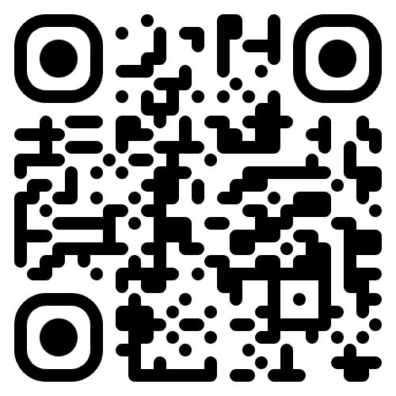
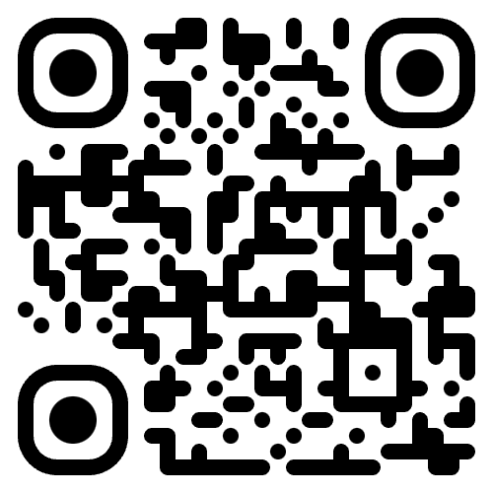
How to Build MicroFrontends?
Single SPA https://single-spa.js.org/
Module Federation https://module-federation.io/

Slide 19
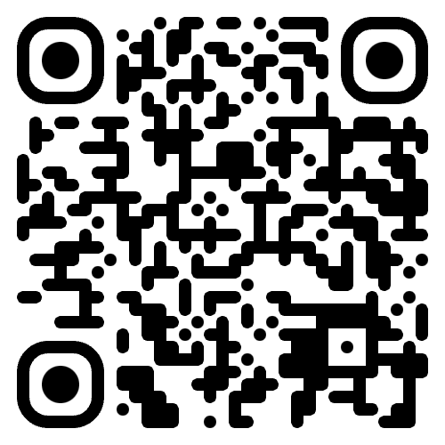
Example Application with Single SPA
https://github.com/niyowski/frontend-at-scale

Slide 20
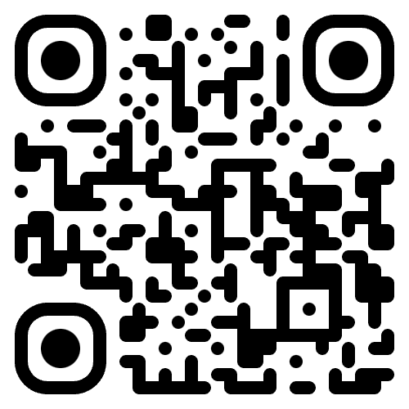
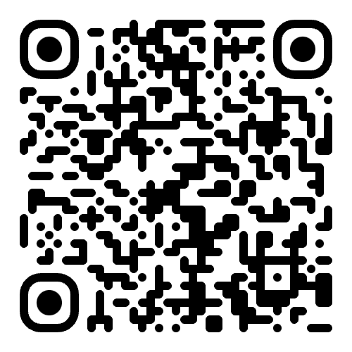
Follow us
Telegram https://t.me/frontspotkazakhstan
Instagram @frontspot.asia

Slide 21


